Slide 1
Pizza Sales Project Report
Presented by –Vaibhav Dixit

Slide 2
Data Description
File Type - .CSV(comma separated value)
Pizza Sales Data
There are 4 tables in the Data :- (order_details, orders, pizza_type, pizza)
Data Source-Kaggle

Slide 3
Prerequisite & Data Cleaning
Null Handling.
Noise Handling.
Removing of Error from the Data.
Create some new measures.
Removing of irrelevant columns.

Slide 4
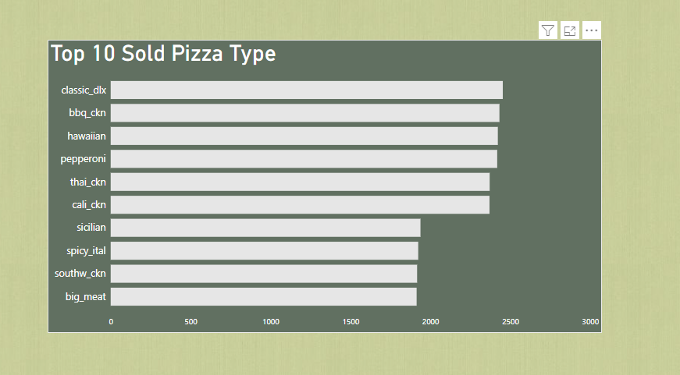
Top 10 Sold Pizza Type

Slide 5
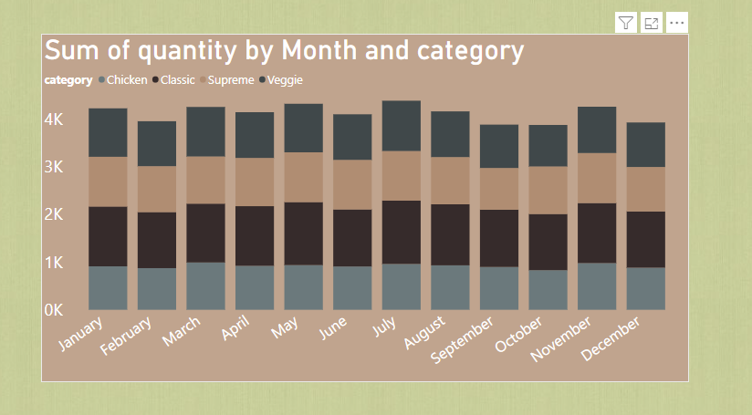
Total Ordered Pizza Category-wise

Slide 6
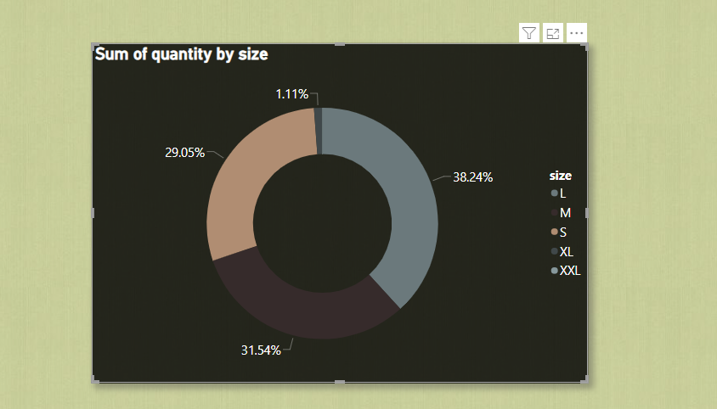
Total Ordered Quantity by Size

Slide 7
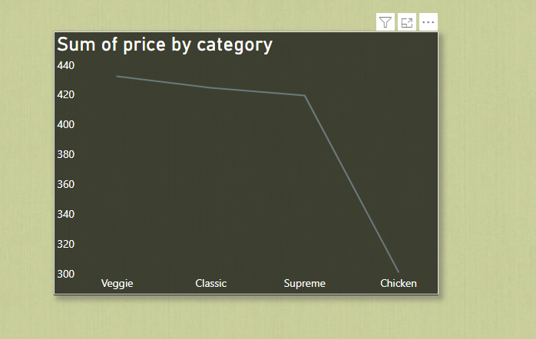
Price of Pizza Category-wise

Slide 8
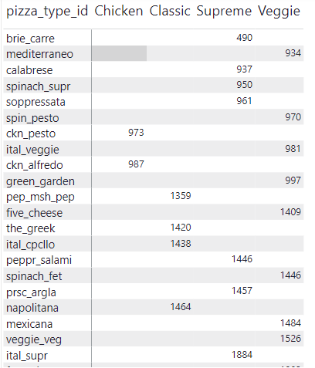
Different Order for different category

Slide 9
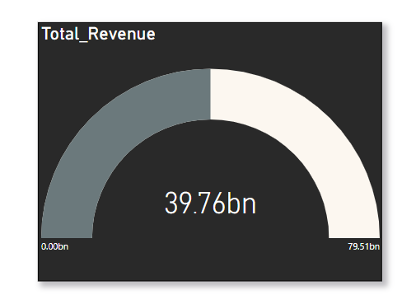
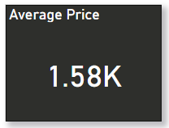
Some Important KPIs

Slide 10
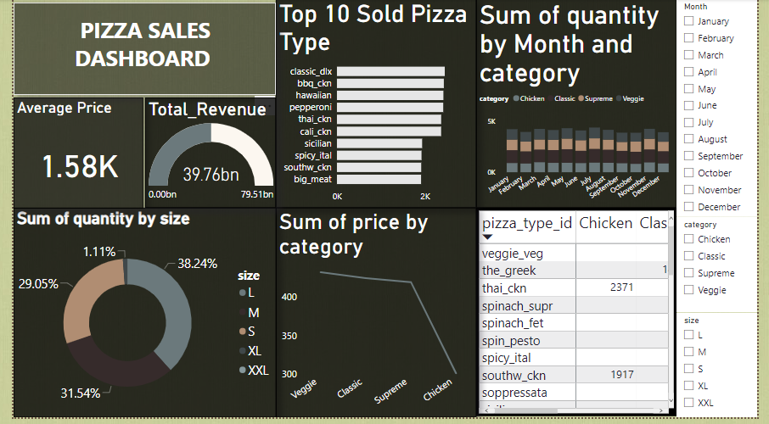
Dash Board

Slide 11
Insights
Most quantity ordered in the July month of the year 2015. And least quantity ordered in September and October.
Most of the revenue is generating through large size pizza. And least from XL size so we need to think about this.
Most pizza type sold of classic_dlx and least veggie veg.
Average order price is 1.58 K for different types of pizza.
Company’s total revenue is 39.76 bn for the year 2015.

Slide 12
Thank you

